Slide 1
Population Modeling
Cole Brookson & Alex Davis
19 October 2021

Slide 2
Biology is Math

Slide 3

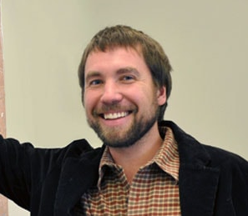

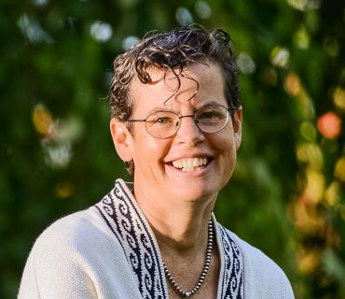
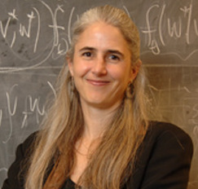


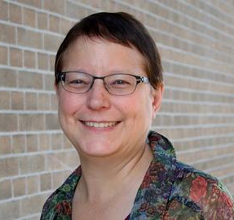


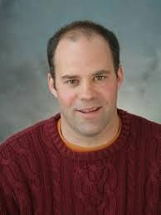
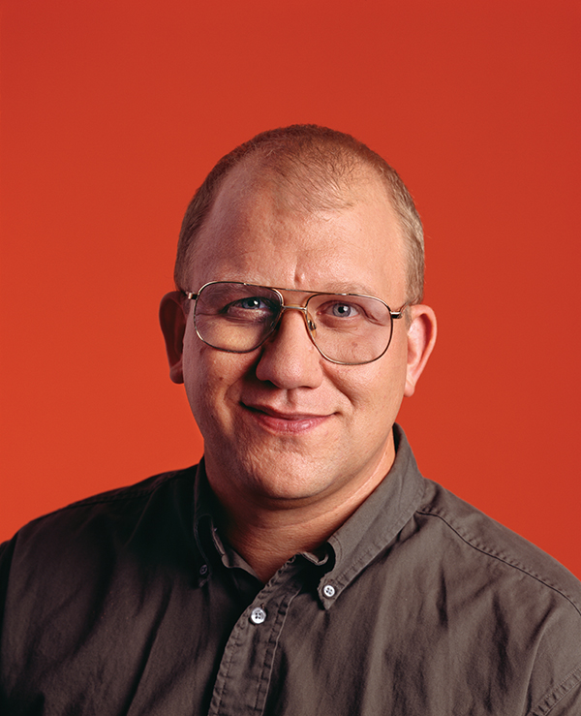
Mark Kot - Washington
Sally Otto - UBC
Mark Lewis – UAlberta/UVic
Martin Krkosek - UToronto
Mercedes Pascual – UChicago
Troy Day - Queens
Jennifer Dunne – Santa Fe
Hal Caswell - WHOI
Michael Dietze – Boston University
Marie-Josee Fortin - UToronto
Kevin McCann -
Guelph
Bill Fagn – Maryland
Notes:
The people who came before me
Good to note there are more white men named mark on this slide then there are women of colour but here we are...

Slide 4

Is it biology really math though??
35% of Ecology and Evolution papers, and 60% of American Naturalist papers had results that depended on a mathematical model
“A picture is a 1000 words” –> well an equation is (sometimes) worth even more
Otto & Day (2007)

Slide 5
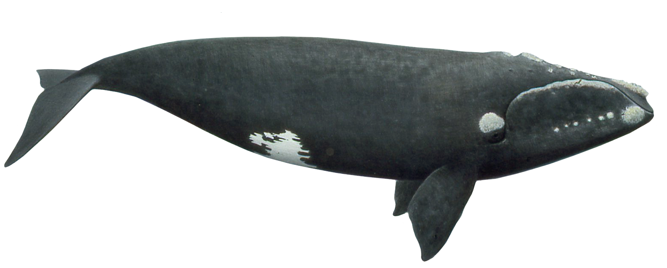
Why do we use models?
Notes:
Ask if anyone knows what this is
Northern right whale – a great marine example of “WHY” we use models in ecology to ask ecological (and management-related) questions

Slide 6
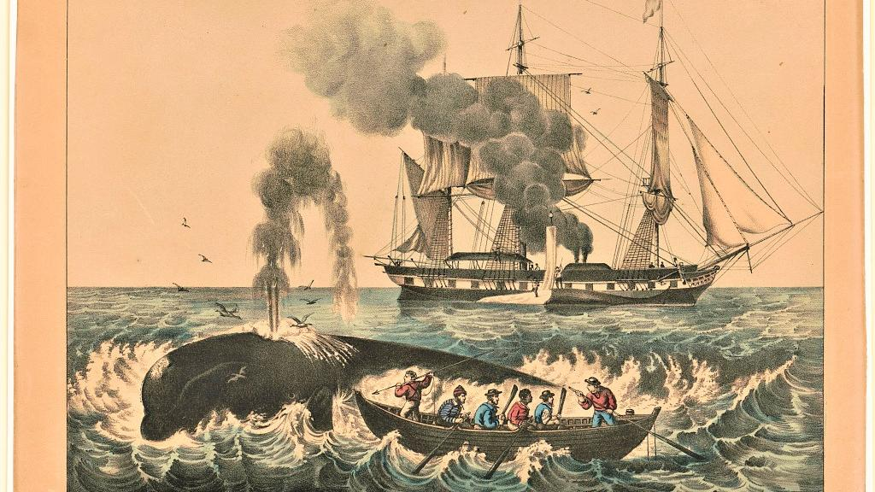
Notes:
Because of their docile nature, their slow surface-skimming feeding behaviors, their tendencies to stay close to the coast, and their high blubber content (which makes them float when they are killed, and which produced high yields of whale oil), right whales were once a preferred target for whalers.

Slide 7
How do you know if the right whale will or will not recover?
Impossible to answer this question without a model!
Notes:
The problem is: we don’t actually KNOW how the whales will grow next year, we can only guess. And given limited resources, we have to make some assumptions about how a population will grow. In order to do that, let’s frame it mathematically

Slide 8
How do you know if the right whale will or will not recover?
Well, let’s frame it as a mathematical question
Notes:
The problem is: we don’t actually KNOW how the whales will grow next year, we can only guess. And given limited resources, we have to make some assumptions about how a population will grow. In order to do that, let’s frame it mathematically

Slide 9
But wait, to do so, we need a more specific biological question

Slide 10
7 Steps to Modeling A Biological Problem
1. Formulate the question
2. Determine the basic ingredients
3. Qualitatively describe the biological system
4. Quantitatively describe the biological system
5. Analyze the equations
6. Checks & balances
7. Relate the results back to the question
Otto & Day (2007)

Slide 11
7 Steps to Modeling A Biological Problem
1. Formulate the question
2. Determine the basic ingredients
3. Qualitatively describe the biological system
4. Quantitatively describe the biological system
5. Analyze the equations
6. Checks & balances
7. Relate the results back to the question
Otto & Day (2007)

Slide 12
But wait, to do so, we need a more specific biological question
“How will northern right whale populations grow?”

